Slide 1
Operator precedence and associativity

Slide 2
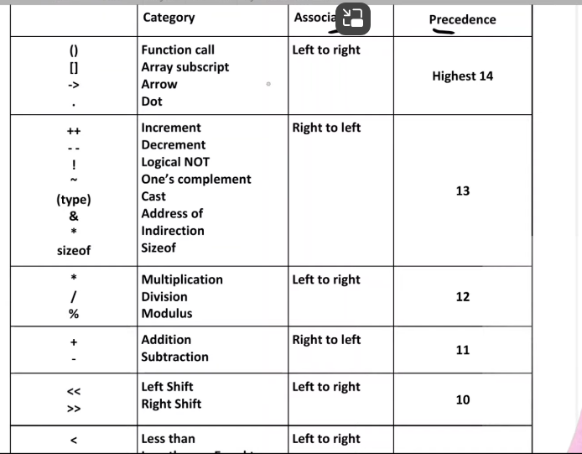

Slide 3
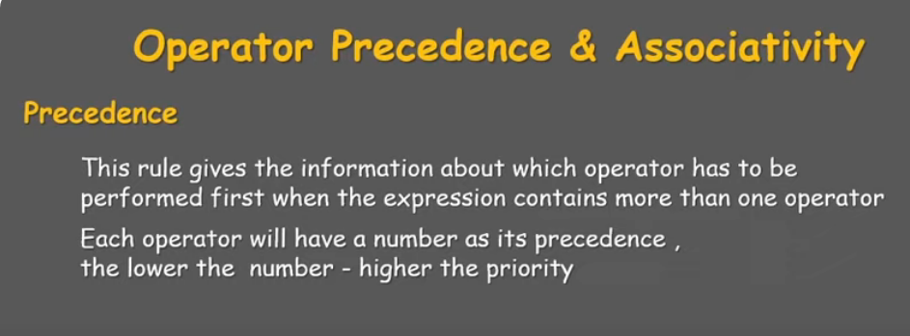
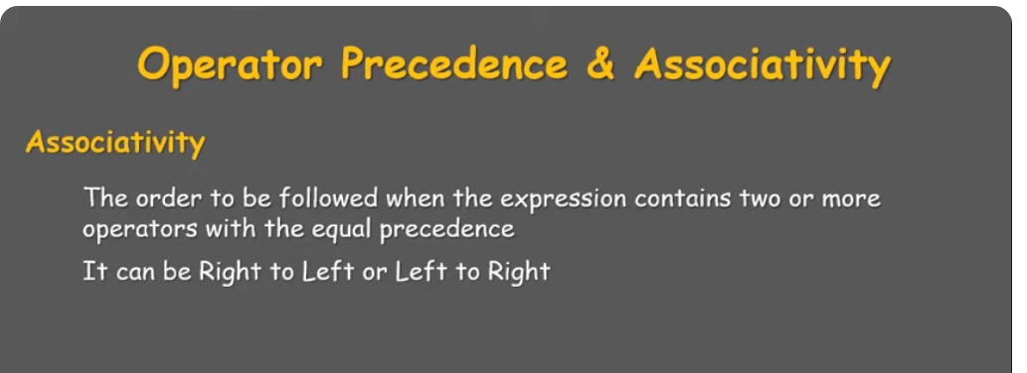

Slide 4
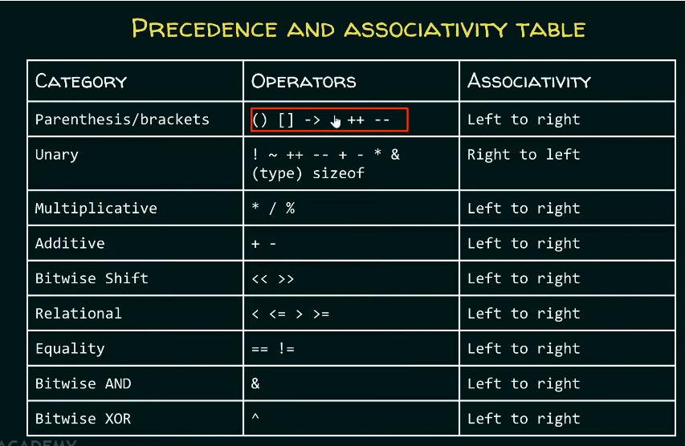

Slide 5
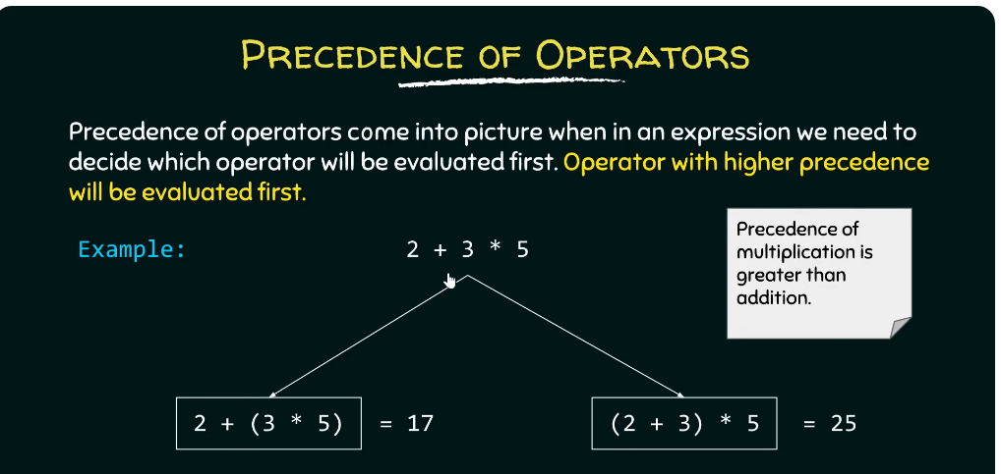

Slide 6
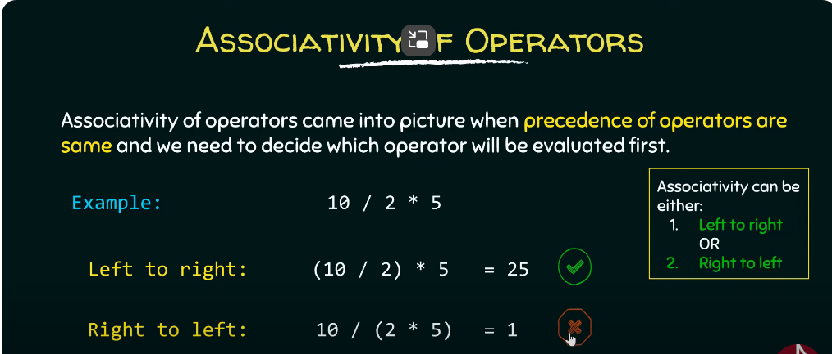

Slide 7
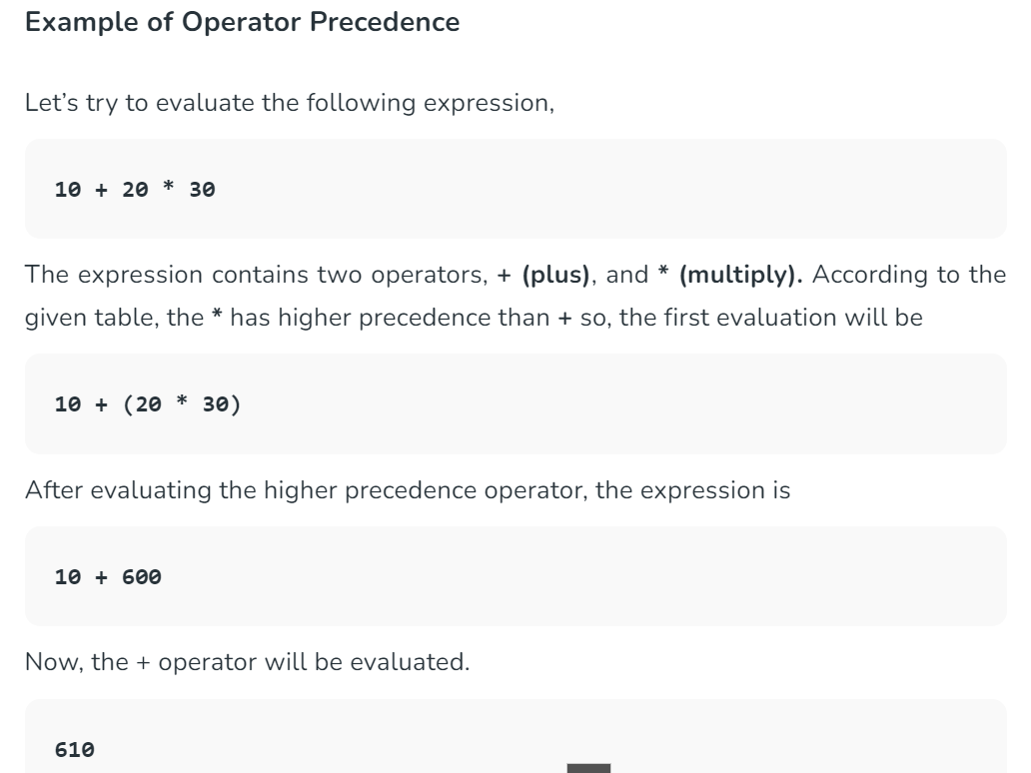

Slide 8
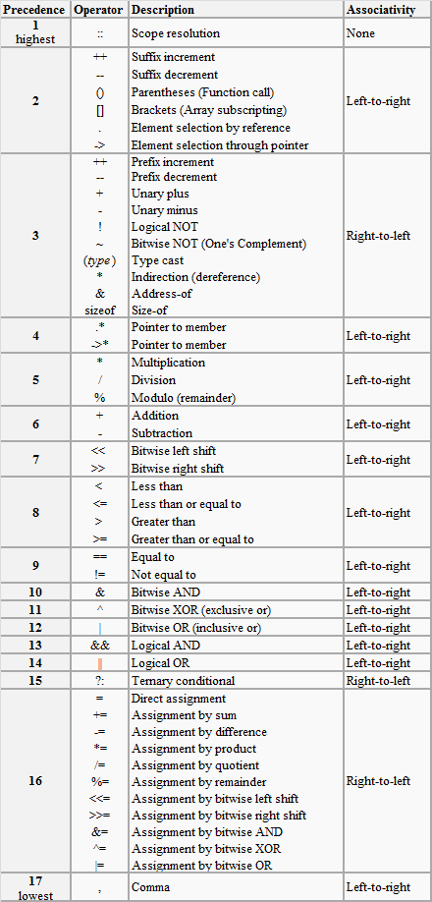
Summary of Operators
Detailed
Precedence
Table

Slide 9
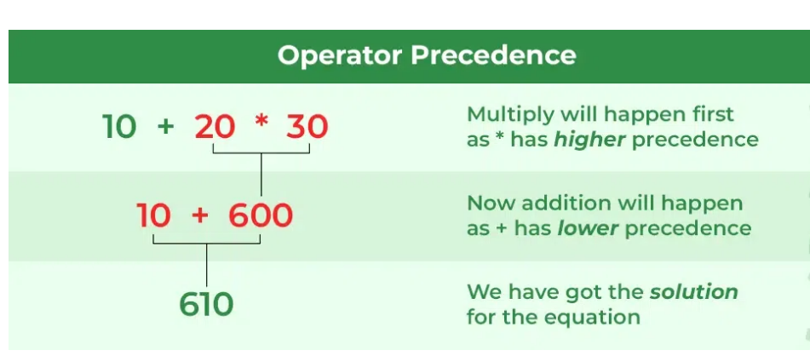

Slide 10
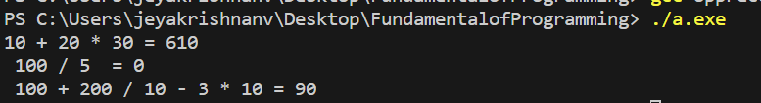
// C Program to illustrate operator precedence
#include <stdio.h>
int main()
{
// printing the value of same expression
printf("10 + 20 * 30 = %d", 10 + 20 * 30);
printf("\n 100 / 5 % 2 = %d", 100 / 5 % 2);
int exp = 100 + 200 / 10 - 3 * 10;
printf("\n 100 + 200 / 10 - 3 * 10 = %d", exp);
return 0;
}

Slide 11
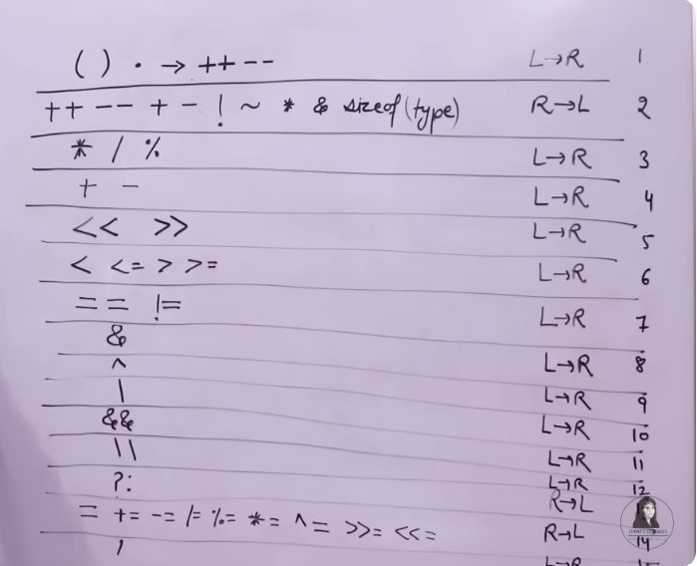

Slide 12
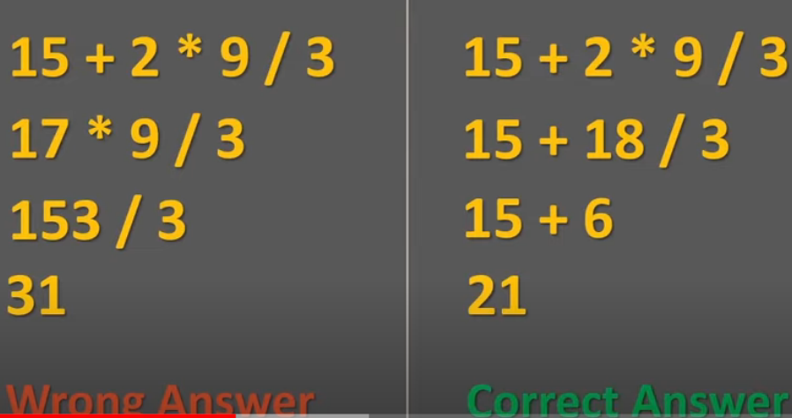

Slide 13
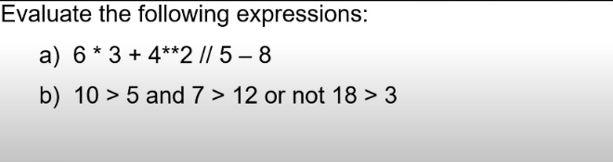
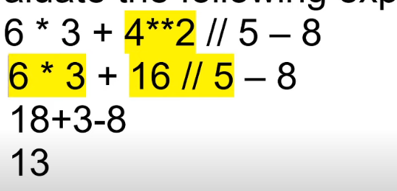

Slide 14
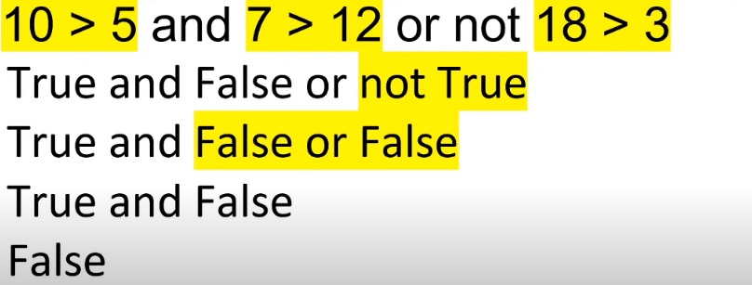

Slide 15
Example:
Show all the steps how the following expression is evaluated. Consider the initial values of i=8, j=5.
2*((i/5)+(4*(j-3))%(i+j-2))

Slide 16
Example solution:
2*((i/5)+(4*(j-3))%(i+j-2)) i→8, j→5
2*((8/5)+(4*(5-3))%(8+5-2))
2*(1+(4*2)%11)
2*(1+8%11)
2*(1+8)
2*9
18

Slide 17
Operator precedence & Associativity
Ex: (x==10 + 15 && y < 10)
Assume x=20 and y=5
Evaluation:
+ (x==25 && y< 10)
< (x==25 && true)
== (False && true)
&& (False)

Slide 18
Tutorial Problems
Suppose that a=2, b=3 and c=6, What is the answer for the following:
(a==5) (a * b > =c) (b+4 > a *c) ((b=2)==a)
Evaluate the following: 1. ( (5 == 5) && (3 > 6) ) 2. ( (5 == 5) || (3 > 6) ) 3. 7==5 ? 4 : 3 4. 7==5+2 ? 4 : 3 5. 5>3 ? a : b 6. K = (num > 5 ? (num <= 10 ? 100 : 200) : 500); where num =30
In b=6.6/a+(2*a+(3*c)/a*d)/(2/n); which operation will be performed first.
If a is an integer variable, a=5/2; will return a value??
The expression, a=7/22*(3.14+2)*3/5; evaluates to??
If a is an Integer, the expression a = 30 * 1000 + 2768; evaluates to??

